Slide 1
Contact Clock
CS 481
Emily Arango, Francis Dator, Gerald De Vera, Tiffany Green, Adrian Manrique

Slide 2
Presentation Overview
Features
Database
Demo
Problems
Future System Goals

Slide 3

Features
Alarm Clock
Personalized Schedule
Weather
News Report
Users are able to set Alarm Time
User can create an Event Reminder
Retrieve Weather report for local area
View Daily world or local news

Slide 4
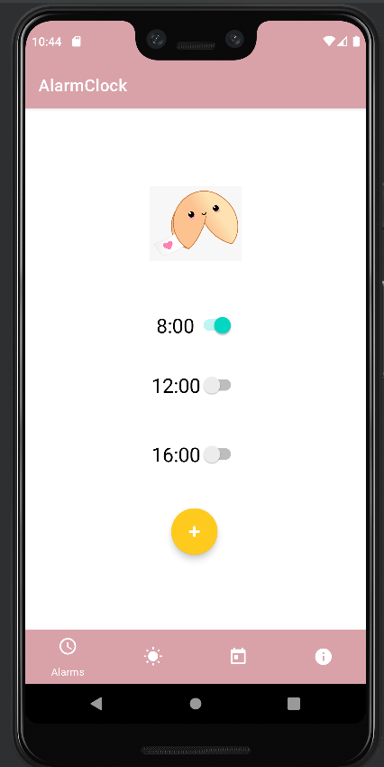
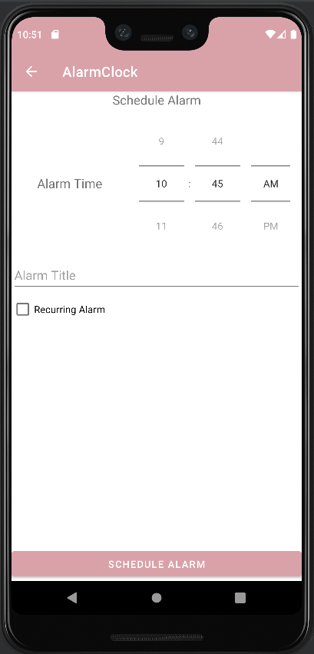
Implementation
Bottom Navigation
Firebase
Recycler View

Slide 5
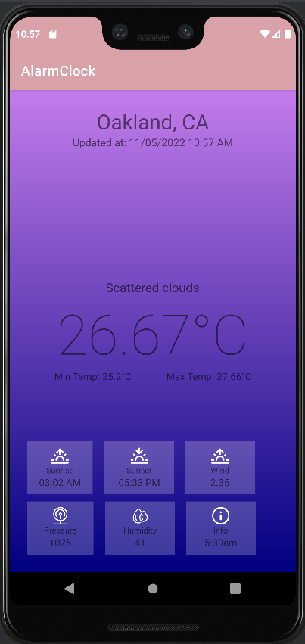
Weather
Weather API
Linear Layout
Created an API key to use OpenWeatherMap.
Formatting to show the other weather info graphics

Slide 6
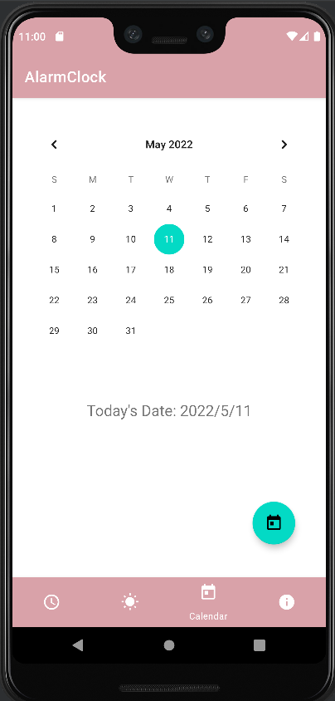
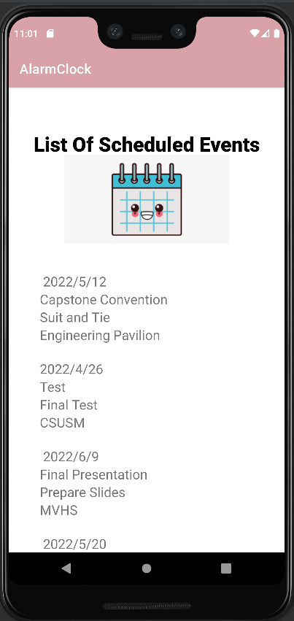
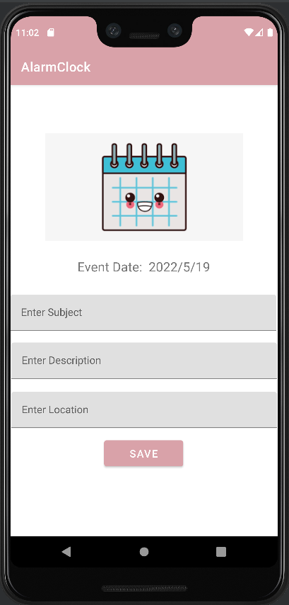
Calendar + Event Creator
Calendar View
Recycler View
Used to display all scheduled events that have been created

Slide 7
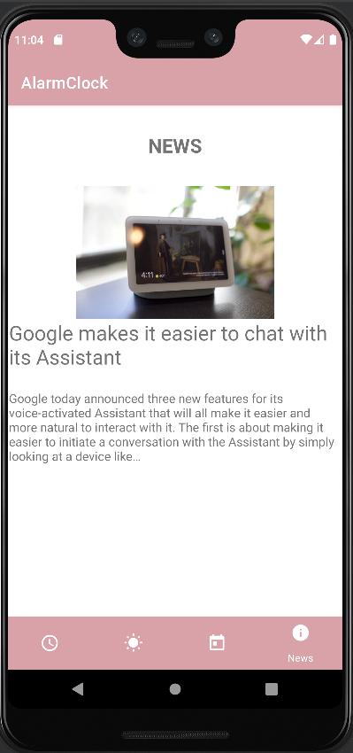
News
News API
Recycler View
Used to locate articles and breaking news headlines
Used to display all the articles in a fast and efficient manner

Slide 8
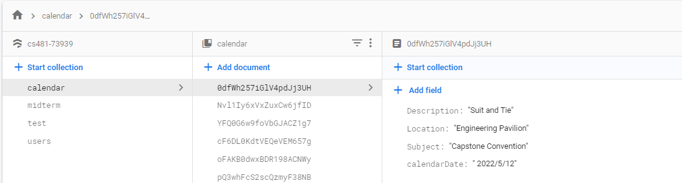
Database Usage
Alarms
Event Creator/Reminder

Slide 9
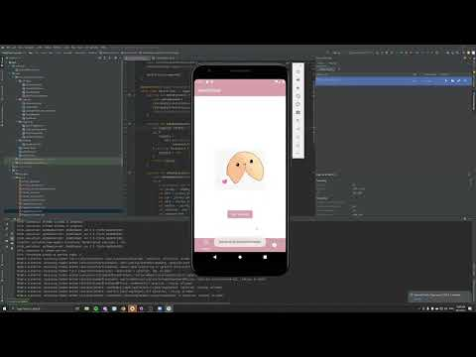
Demo

Slide 10
Problems
Limited Time
Unfinished Tasks
Unexpected Errors
Inaccuracy in implemented API’s
Unfamiliarity with API’s to be
Lack of API access for features

Slide 11
Future System Goals
Alarm Interactivity
Display Event Notifications
Display list of Alarms
Fix Inaccuracy with Weather data.

Slide 12
Any Questions?

